Slide 1

FinWise AI
Next-Generation Personal Finance Intelligence & Real-Time Advisory Ecosystem

Slide 2

Executive Summary
Empowering individuals with deterministic financial projection engines coupled with LLM-based intelligent wealth storytelling.

Slide 3


Core Value Proposition
Deterministic Accuracy
Intelligent Narratives
Combines exact numerical forecasting algorithms with scenario models, eliminating hallucinated calculations and delivering precise cash flow trajectories.
Leverages LLM reasoning via LangChain & Gemini API to translate complex numerical projections into actionable, plain-English financial advice.

Slide 4






Key Platform Features
Cash Flow Engine
Risk & Health Scoring
Advisory Assistant
Automated projections of net cash flow, savings rate, and growth trajectory over custom time horizons.
Multidimensional scoring based on emergency reserves, debt-to-income ratios, and savings stability.
Context-aware AI financial planner answering user queries using live cash flow parameters.

Slide 5
Technical Architecture
Modular end-to-end stack built for scalability, computational precision, and seamless user interaction.

Slide 6

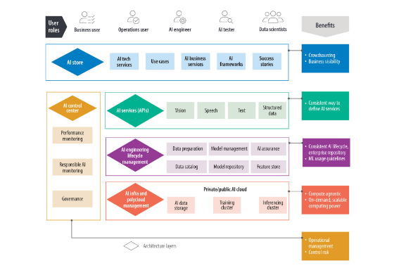
Architecture & Data Flow
System Workflow
FinWise decouples numerical computations from narrative generation:
1. User inputs financial data into the Streamlit interface. 2. Deterministic Engine computes health metrics & cash flows. 3. LangChain context-builder constructs prompt payloads. 4. Gemini API synthesizes personalized advice.

Slide 7

Financial Health Scoring
Algorithmic Assessment
FinWise calculates a weighted composite score evaluating liquidity depth, debt burden ratio, discretionary capital allocation, and investment readiness. Users receive real-time updates as financial inputs shift.
Health Index Engine Score

Slide 8
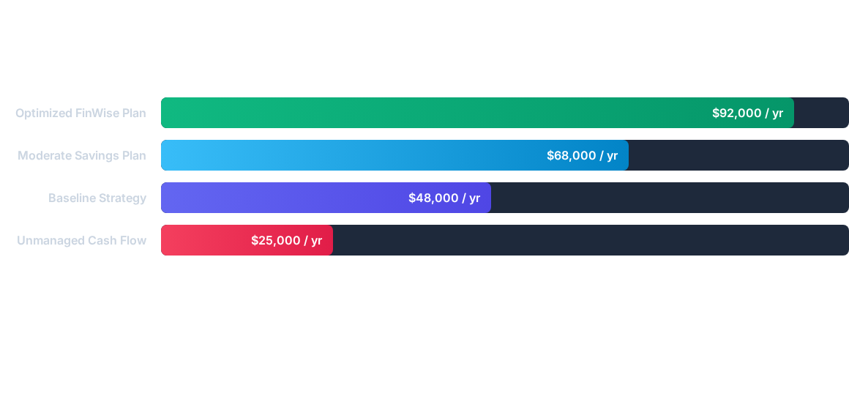
Cash Flow Simulation
Simulated 5-year accumulated wealth potential comparing unmanaged cash flows vs. AI-optimized advisory paths.

Slide 9
AI Advisory Engine
LLM Orchestration: Powered by LangChain pipeline chains for structured prompt execution and memory retention.
Google Gemini API Integration: High-speed inferencing for contextual narrative generation and dynamic advice customization.
Financial Guardrails: Pre-prompt constraints ensure responses stay focused on budgeting, debt management, and realistic savings goals.

Slide 10




Project Roadmap
Phase 2: Streamlit UI
Interactive web dashboard development and visualization integration.
Phase 4: Deployment
Full optimization, edge testing, and public release.
Phase 1: Core Engine
Phase 3: AI Integration
Mathematical cash-flow model and scoring logic design.
LangChain orchestration & Gemini API narrative synthesis.

Slide 11
Feature Comparison
Capability | Traditional Calculators | Generic AI Chatbots | FinWise AI
Math Precision | High | Hallucination Risk | Deterministic Math
Natural Explanations | None | High | Personalized Narratives
Scenario Intelligence | Static Formulas | Unstructured Advice | Contextual AI Advisory
Real-time UI Sync | Basic Tables | Text Output Only | Dynamic Visual Dashboard

Slide 12
Questions & Discussion
Thank you for exploring FinWise AI
FinWise AI Engine • Intelligent Personal Wealth Ecosystem

Slide 13

Image Sources
https://cdn.prod.website-files.com/624717c641bda0f076a77654/66fd3becddda58a1d7260b53_AD_4nXeLlX2FAGyfy_mfiy6yk8t8tGRM0xvxmVgQJISwRYvqdOqreKCdTZlhT6urWRQ1F9K3R6WlibTqkyDQsh5LvPEwl6a8-HId4w2QSlftz9dR_bQH0xvyrFKVI2kC-2ybu2_qY-I-AKIBFNPDg1I5VLQ0GLFD.jpeg
Source: www.zendata.dev

